Slide 1
INTRODUCTION TO PANDAS

Slide 2
What is Pandas?
Pandas is a powerful and flexible open-source data analysis and manipulation library for Python. It provides data structures and functions needed to work on structured data seamlessly and efficiently.
Structured data refers to data that is organized in a tabular format with rows and columns, making it easy to understand and manipulate
Data Structures: Mainly uses Series and DataFrame.
Series: One-dimensional labeled array capable of holding any data type.
DataFrame: Two-dimensional labeled data structure with columns of potentially different types.

Slide 3
Why Use Pandas in Machine Learning?
Pandas is an essential tool in the data preprocessing and exploration stages of a Machine Learning pipeline.
Here are some reasons why Pandas is invaluable:
Data Cleaning: Easily handle missing values, duplicate data, and inconsistent formatting.
Data Transformation: Convert data types, filter rows, and aggregate data.
Data Integration: Merge and join different data sources.
Exploratory Data Analysis (EDA): Provides tools for statistical analysis and visual representation of data.
Efficiency: Optimized for performance with operations like filtering, grouping, and reshaping.
Integration: Works well with other data science libraries like NumPy, Matplotlib, and Scikit-learn.

Slide 4
Key Features of Pandas
DataFrame and Series
Data Handling
Data Manipulation
Time Series Analysis
Performance Optimization

Slide 5
DataFrame and Series
DataFrame: A 2-dimensional labeled data structure with columns of potentially different types.
Series: A 1-dimensional labeled array capable of holding any data type.

Slide 6
Data Handling
Reading/Writing Data: Supports various file formats (CSV, Excel, SQL, JSON).
Handling Missing Data: Methods to identify, remove, or replace missing values.
Data Alignment: Automatically aligns data by labels in arithmetic operations.

Slide 7
Data Manipulation
Filtering and Selecting: Easy access to subsets of data.
Grouping and Aggregation: Group data by certain conditions and perform aggregate operations.
Merging and Joining: Combine data from different DataFrames.

Slide 8
Time Series Analysis
Date Range Generation: Generate sequences of fixed-frequency dates and times.
Resampling: Change the frequency of time series data.
Rolling Window: Apply functions over rolling windows of data.

Slide 9
Performance Optimization
Vectorized Operations: Operations are optimized to perform efficiently on entire arrays of data.
Memory Optimization: Efficient handling of large datasets.

Slide 10
2. Installing Pandas
Depending on your operating system, open the command prompt (Windows) or terminal (macOS/Linux).
First check if python is installed using this command python --version
If Python is not installed, download and install it from the official Python website
Once you have Python and pip installed, you can install Pandas by running: pip install pandas
Verify if Panda is installed
import pandas as pd
print(pd.__version__)

Slide 11
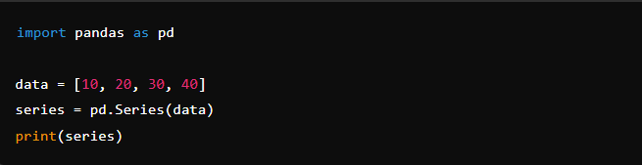
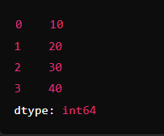
3. Pandas Data Structures
a) Series
Creating a Series
A Series is a one-dimensional labeled array capable of holding any data type (integers, strings, floats, etc.).
Output

Slide 12
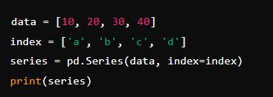
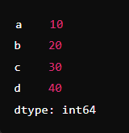
Creating a Series with custom index:

Slide 13
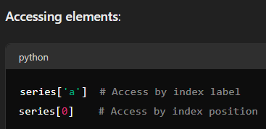
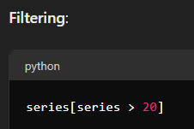
Basic Operations on Series

Slide 14
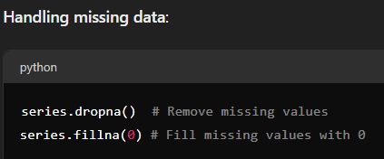

Slide 15
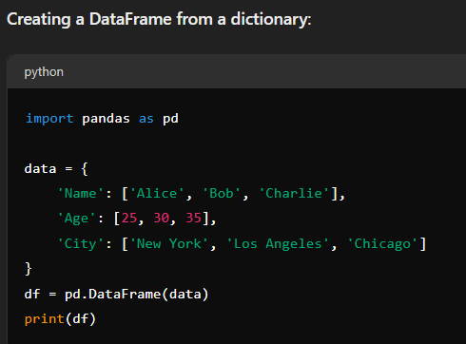
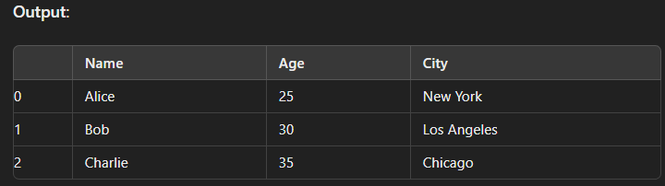

Slide 16
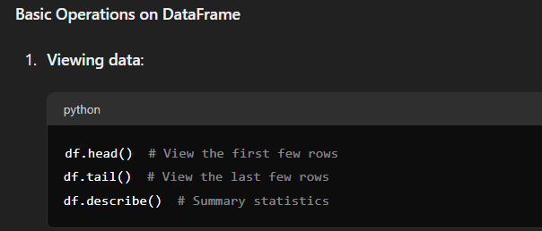

Slide 17
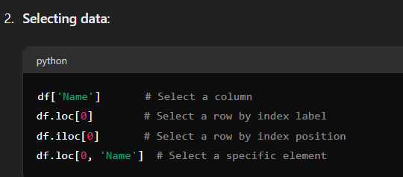

Slide 18
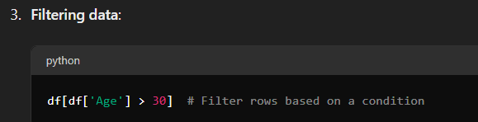

Slide 19
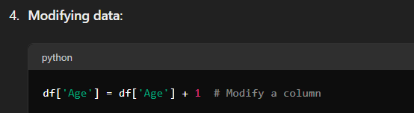

Slide 20
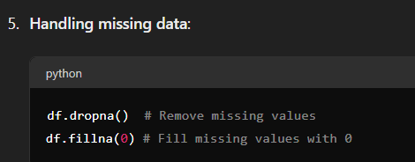

Slide 21
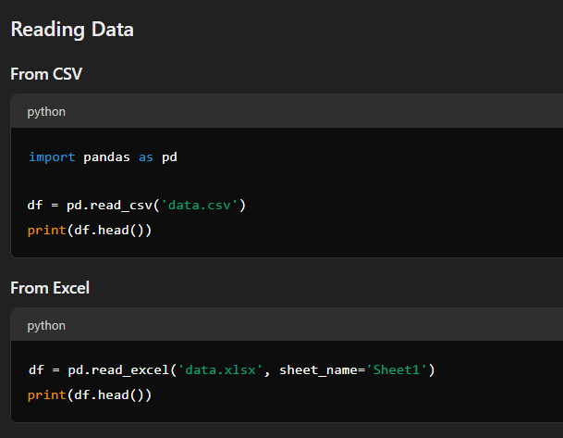
Data Manipulation with Pandas

Slide 22
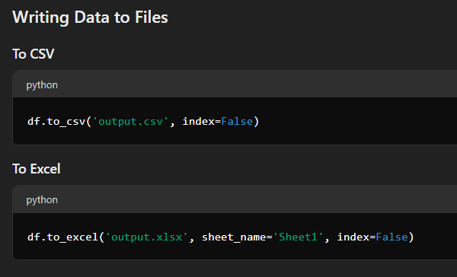

Slide 23
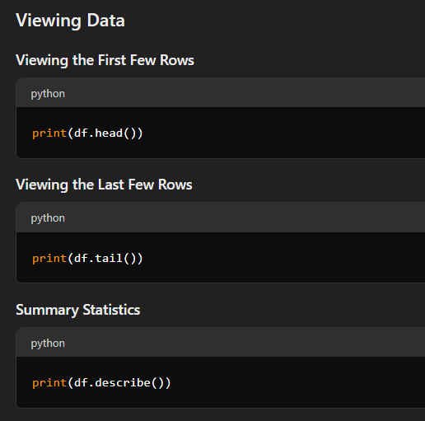

Slide 24
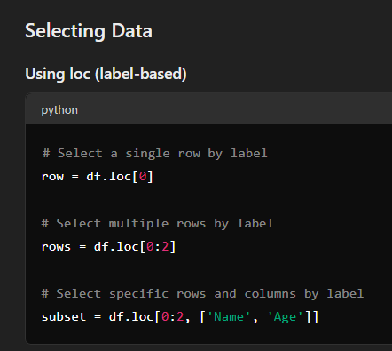
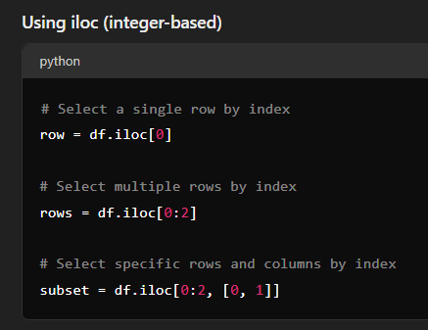

Slide 25
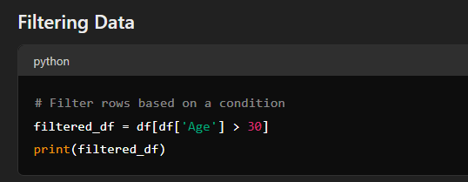

Slide 26
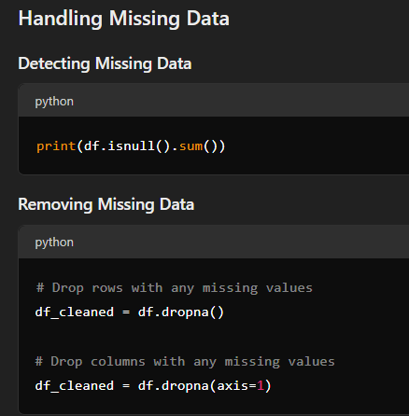
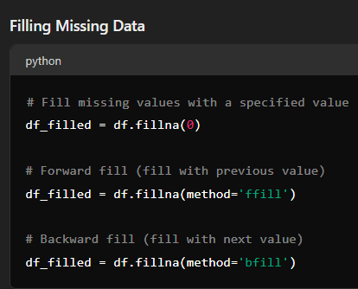

Slide 27
5. Data Cleaning
Removing duplicates
Handling missing values
Data type conversions

Slide 28
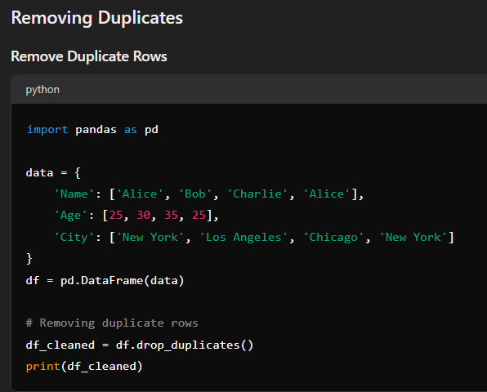

Slide 29
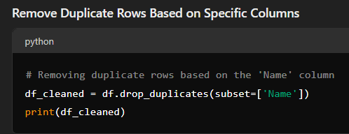
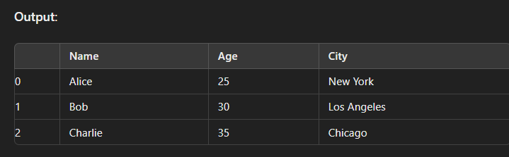

Slide 30
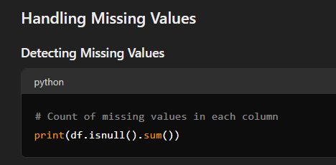
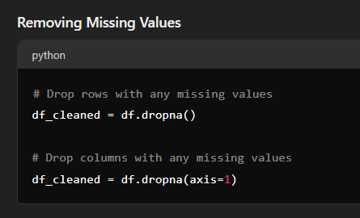

Slide 31
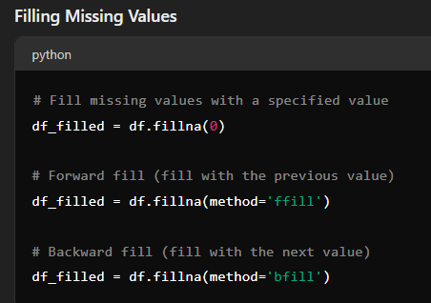

Slide 32
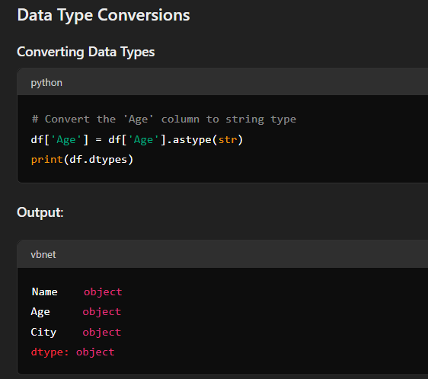

Slide 33
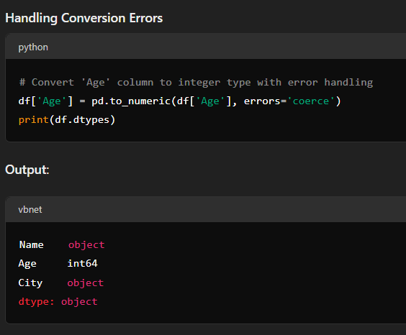

Slide 34
6. Data Analysis
Aggregation (groupby)
Merging and joining DataFrames
Sorting and ranking

Slide 35
7. Data Visualization with Pandas
Plotting basics using Pandas
Line Plot
Bar Plot
Histogram
Scatter Plot
Pie Chart

Slide 36
8. Practical Examples
Real-world datasets
Hands-on examples of data manipulation and analysis

Slide 37
THANK YOU FOR LISTENING

Slide 38
Numpy

